Slide 1
KNAPSACK PROBLEM

Slide 2
PROBLEM & GOAL
We are given n items {1, . . . , n}, and each has a given nonnegative weight wi (for i = 1, . . . , n).
We are also given a bound of Knapsack capacity W.
We would like to select a subset S of the items so that ∑i∈S wi ≤ W and, subject to this restriction, ∑i∈S vi is as large as possible.
We will call this the Knapsack Problem.
2

Slide 3


DESIGNING THE ALGORITHM
Let us consider and optimal solution.
OPT(n, W) = max profit from items 1, …, n with weight limit W.
There can be 2 cases if we consider an nth item as follows
Case 1: OPT does not select item n i.e. n OPT
OPT selects best of { 1, 2, …, n-1 } using weight limit W.
Case 2: OPT selects item n. (i.e. n OPT)
New weight limit = W – wn
OPT selects best of { 1, 2, …, n–1 } using this new weight limit.
3

Slide 4
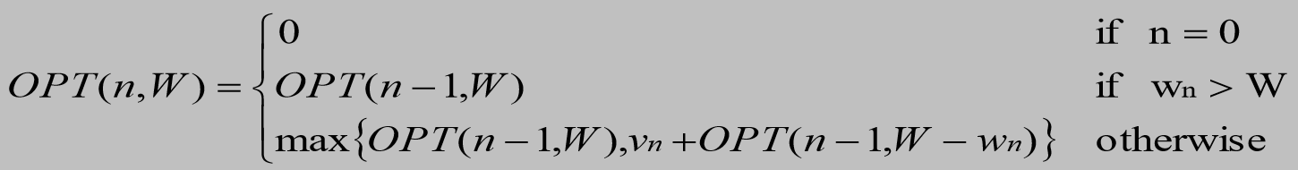
DESIGNING THE ALGORITHM
Recurrence Relation
4

Slide 5
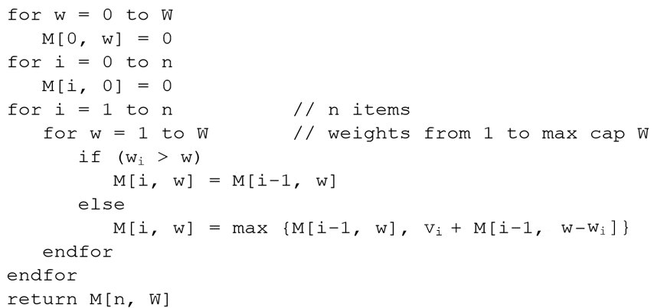
KNAPSACK ALGORITHM
//Purpose: To find the maximum value or profit from the given n items and their weights wi
//Input: A set of items 1,2,…….n, with, w1, … ,wN, and values v1,v2……,vn with knapsack capacity W
//Output: Max Profit M[n, W]
5

Slide 6
KNAPSACK EXAMPLE
ITEMS | WEIGHTS | VALUES | W = 5
1 | 2 | 20
2 | 2 | 10
3 | 3 | 30
 | 0 | 1 | 2 | 3 | 4 | 5
0 | 0 | 0 | 0 | 0 | 0 | 0
1 | 0
2 | 0
3 | 0
6

Slide 7
KNAPSACK EXAMPLE
i | wi | w | wi > w | M [i, w]
1 | 2 | 1 | 2 > 1 TRUE | M[i, w] = M[i-1, w] = M[0, 1] = 0
 |  | 2 | 2 > 2 FALSE | = Max {M[i-1, w], vi + M[i-1, w-wi] } = Max ( M [0 , 2 ] , 20 + M [ 0 , 0 ] ) = Max(0,20) = 20
 | 0 | 1 | 2 | 3 | 4 | 5
0 | 0 | 0 | 0 | 0 | 0 | 0
1 | 0 | 0 | 20
2 | 0
3 | 0
7

Slide 8
KNAPSACK EXAMPLE
i | wi | w | wi > w | M [i, w]
1 | 2 | 3 | 2 > 3 FALSE | = Max {M[i-1, w], vi + M[i-1, w-wi] } = Max ( M [ 0 , 3 ] , 20 + M [ 0 , 1 ] ) = Max ( 0 , 20 ) = 20
 |  | 4 | 2 > 4 FALSE | = Max {M[i-1, w], vi + M[i-1, w-wi] } = Max ( M [ 0 , 4 ] , 20 + M [ 0 , 2 ] ) = Max ( 0 , 20 ) = 20
 | 0 | 1 | 2 | 3 | 4 | 5
0 | 0 | 0 | 0 | 0 | 0 | 0
1 | 0 | 0 | 20 | 20 | 20
2 | 0
3 | 0
8

Slide 9
KNAPSACK EXAMPLE
i | wi | w | wi > w | M [i, w]
1 | 2 | 5 | 2 > 5 FALSE | = Max {M[i-1, w], vi + M[i-1, w-wi] } = Max ( M [ 0 , 5 ] , 20 + M [ 0 , 3 ] ) = Max ( 0 , 20 ) = 20
 | 0 | 1 | 2 | 3 | 4 | 5
0 | 0 | 0 | 0 | 0 | 0 | 0
1 | 0 | 0 | 20 | 20 | 20 | 20
2 | 0
3 | 0
9

Slide 10
KNAPSACK EXAMPLE
i | wi | w | wi > w | M [i, w]
2 | 2 | 1 | 2 > 1 TRUE | M[i, w] = M[i-1, w] = M [1, 1] = 0
 |  | 2 | 2 > 2 FALSE | = Max {M[i-1, w], vi + M[i-1, w-wi] } = Max ( M [1 , 2 ] , 10 + M [ 1 , 0 ] ) = Max ( 20 , 10 ) = 20
 | 0 | 1 | 2 | 3 | 4 | 5
0 | 0 | 0 | 0 | 0 | 0 | 0
1 | 0 | 0 | 20 | 20 | 20 | 20
2 | 0 | 0 | 20
3 | 0
10

Slide 11
KNAPSACK EXAMPLE
i | wi | w | wi > w | M [i, w]
2 | 2 | 3 | 2 > 3 FALSE | = Max {M[i-1, w], vi + M[i-1, w-wi] } = Max ( M [1 , 3 ] , 10 + M [ 1 , 1 ] ) = Max ( 20 , 10 ) = 20
 |  | 4 | 2 > 4 FALSE | = Max {M[i-1, w], vi + M[i-1, w-wi] } = Max ( M [1 , 4 ] , 10 + M [ 1 , 2 ] ) = Max ( 20 , 30 ) = 30
 | 0 | 1 | 2 | 3 | 4 | 5
0 | 0 | 0 | 0 | 0 | 0 | 0
1 | 0 | 0 | 20 | 20 | 20 | 20
2 | 0 | 0 | 20 | 20 | 30
3 | 0
11

Slide 12
KNAPSACK EXAMPLE
i | wi | w | wi > w | M [i, w]
2 | 2 | 5 | 2 > 5 FALSE | = Max {M[i-1, w], vi + M[i-1, w-wi] } = Max ( M [1 , 5 ] , 10 + M [ 1 , 3 ] ) = Max ( 20 , 30 ) = 30
 | 0 | 1 | 2 | 3 | 4 | 5
0 | 0 | 0 | 0 | 0 | 0 | 0
1 | 0 | 0 | 20 | 20 | 20 | 20
2 | 0 | 0 | 20 | 20 | 30 | 30
3 | 0
12

Slide 13
KNAPSACK EXAMPLE
i | wi | w | wi > w | M [i, w]
3 | 3 | 1 | 3 > 1 TRUE | M[i, w] = M[i-1, w] = M [ 2, 1 ] = 0
 |  | 2 | 3 > 2 TRUE | M[i, w] = M[i-1, w] = M [ 2 , 2 ] = 20
 | 0 | 1 | 2 | 3 | 4 | 5
0 | 0 | 0 | 0 | 0 | 0 | 0
1 | 0 | 0 | 20 | 20 | 20 | 20
2 | 0 | 0 | 20 | 20 | 30 | 30
3 | 0 | 0 | 20
13

Slide 14
KNAPSACK EXAMPLE
i | wi | w | wi > w | M [i, w]
3 | 3 | 3 | 3 > 3 FALSE | = Max {M[i-1, w], vi + M[i-1, w-wi] } = Max ( M [2 , 3 ] , 30 + M [ 2 , 0 ] ) = Max ( 20 , 30 ) = 30
 |  | 4 | 3 > 4 FALSE | = Max {M[i-1, w], vi + M[i-1, w-wi] } = Max ( M [2 , 4 ] , 30 + M [ 2 , 1 ] ) = Max ( 30 , 30 ) = 30
 | 0 | 1 | 2 | 3 | 4 | 5
0 | 0 | 0 | 0 | 0 | 0 | 0
1 | 0 | 0 | 20 | 20 | 20 | 20
2 | 0 | 0 | 20 | 20 | 30 | 30
3 | 0 | 0 | 20 | 30 | 30
14

Slide 15
KNAPSACK EXAMPLE
i | wi | w | wi > w | M [i, w]
3 | 3 | 5 | 3 > 5 FALSE | = Max {M[i-1, w], vi + M[i-1, w-wi] } = Max ( M [2 , 5 ] , 30 + M [ 2 , 2 ] ) = Max ( 30 , 30 + 20 ) = Max ( 30 , 50 ) = 50
 | 0 | 1 | 2 | 3 | 4 | 5
0 | 0 | 0 | 0 | 0 | 0 | 0
1 | 0 | 0 | 20 | 20 | 20 | 20
2 | 0 | 0 | 20 | 20 | 30 | 30
3 | 0 | 0 | 20 | 30 | 30 | 50
15

Slide 16
KNAPSACK EXAMPLE
ITEMS | WEIGHTS | VALUES | W = 5
1 | 2 | 20
2 | 2 | 10
3 | 3 | 30
 | 0 | 1 | 2 | 3 | 4 | 5
0 | 0 | 0 | 0 | 0 | 0 | 0
1 | 0 | 0 | 20 | 20 | 20 | 20
2 | 0 | 0 | 20 | 20 | 30 | 30
3 | 0 | 0 | 20 | 30 | 30 | 50
SOLUTION
16

Slide 17
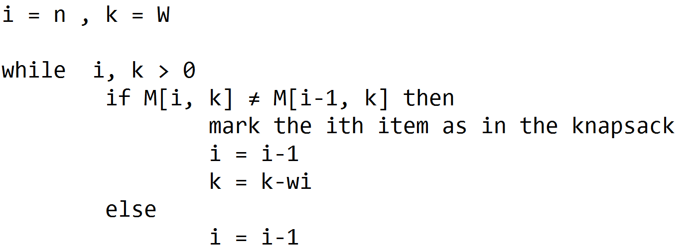
FIND ITEMS IN KNAPSACK
In order to find the items that belong to the knapsack, we use the global array M[n,W] computed and find the items using the following algorithm.
Algorithm: Find_items_in_knapsack()
// Input: Global array M[n,W] giving the maximum value achievable for “n” set of items and knapsack capacity “W”.
//Output: The items “i” that belong to the Knapsack.
17

Slide 18
EXAMPLE FIND ITEMS IN KNAPSACK
ITEMS | WEIGHTS | VALUES | W = 5
1 | 2 | 20
2 | 2 | 10
3 | 3 | 30
 | 0 | 1 | 2 | 3 | 4 | 5
0 | 0 | 0 | 0 | 0 | 0 | 0
1 | 0 | 0 | 20 | 20 | 20 | 20
2 | 0 | 0 | 20 | 20 | 30 | 30
3 | 0 | 0 | 20 | 30 | 30 | 50
18

Slide 19
EXAMPLE FIND ITEMS IN KNAPSACK
i | k | Global Array M[n, w] | Items in the Knapsack
3 | 5
 |  | k = k – wi = 5 – 3 =2 i = i – 1 = 2
 | 0 | 1 | 2 | 3 | 4 | 5
0 | 0 | 0 | 0 | 0 | 0 | 0
1 | 0 | 0 | 20 | 20 | 20 | 20
2 | 0 | 0 | 20 | 20 | 30 | 30
3 | 0 | 0 | 20 | 30 | 30 | 50
3
19
Notes:
19

Slide 20
EXAMPLE FIND ITEMS IN KNAPSACK
i | k | Global Array M[n, w] | Items in the Knapsack
2 | 2
 |  | i = i – 1 = 2 – 1 i = 1
 | 0 | 1 | 2 | 3 | 4 | 5
0 | 0 | 0 | 0 | 0 | 0 | 0
1 | 0 | 0 | 20 | 20 | 20 | 20
2 | 0 | 0 | 20 | 20 | 30 | 30
3 | 0 | 0 | 20 | 30 | 30 | 50
3
20
Notes:
20

Slide 21
EXAMPLE FIND ITEMS IN KNAPSACK
i | k | Global Array M[n, w] | Items in the Knapsack
1 | 2
 |  | k = k – 2 = 0 i = i – 1 = 0
 | 0 | 1 | 2 | 3 | 4 | 5
0 | 0 | 0 | 0 | 0 | 0 | 0
1 | 0 | 0 | 20 | 20 | 20 | 20
2 | 0 | 0 | 20 | 20 | 30 | 30
3 | 0 | 0 | 20 | 30 | 30 | 50
3, 1
21
Notes:
21

Slide 22
THANK YOU
22

